Slide 1
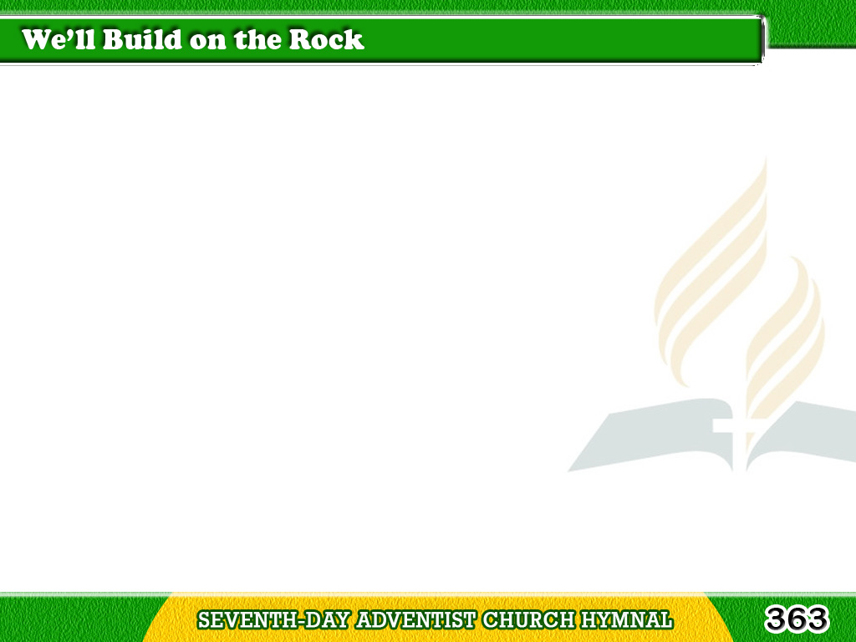
1/3
We’ll build on the Rock,
the living Rock,
On Jesus, the Rock of Ages;
Tagalog
Version

Slide 2
1/3
So shall we abide
the fearful shock,
When loud the tempest rages.
Tagalog
Version

Slide 3
1/3
Chorus
We’ll build on the Rock,
We’ll build on the Rock;
We’ll build on the Rock,
on the solid Rock,
On Christ, the mighty Rock.
Tagalog
Version

Slide 4
2/3
Some build on
the sinking sands of life,
On visions on earthly treasure;
Tagalog
Version

Slide 5
2/3
Some build on the waves
of sin and strife,
Of fame, and worldly pleasure.
Tagalog
Version

Slide 6
2/3
Chorus
We’ll build on the Rock,
We’ll build on the Rock;
We’ll build on the Rock,
on the solid Rock,
On Christ, the mighty Rock.
Tagalog
Version

Slide 7
3/3
O build on the Rock
forever sure,
The firm and the true foundation;
Tagalog
Version

Slide 8
3/3
Its hope is the hope
which shall endure,
The hope of our salvation.
Tagalog
Version

Slide 9
3/3
Chorus
We’ll build on the Rock,
We’ll build on the Rock;
We’ll build on the Rock,
on the solid Rock,
On Christ, the mighty Rock.
Tagalog
Version

